Slide 1
INTRODUCTION TO DOCKER

Slide 2
Presented By
Tsholofelo Pole & Renette Ros
You can find us at:
@tsholofelo.pole@entelect.co.za
@renette.ros@entelect.co.za
👧👩

Slide 3
1
What is Docker?
Let’s start talking about Docker?

Slide 4
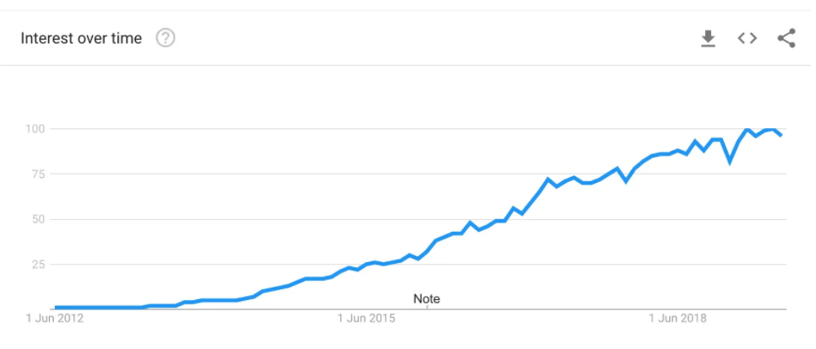
WHAT IS DOCKER?

Slide 5

WHAT IS DOCKER?
An open-source project that automates the deployment of software applications inside containers by providing an additional layer of abstraction and automation of Operating System-level virtualization on Linux.

Slide 6

WHAT IS DOCKER?
Allows developers to package an application and its dependencies into a standardized unit - container

Slide 7
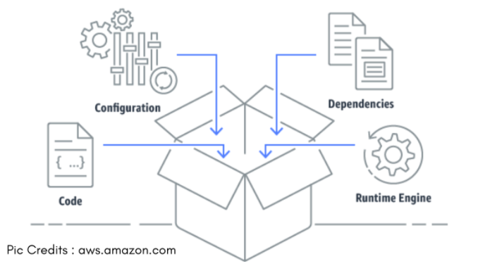
WHAT IS A CONTAINER?
A container is the actual isolated environment running your application
Notes:
container -> installed instance of that software
A container contains: a docker image, an execution env and a set of instructions.
a container is basically an image that is running in your host OS. A Docker container containerized (wraps) an application’s software into an invisible box with everything the application needs to run. That includes the operating system, application code, runtime, system tools, system libraries, and etc.

Slide 8

Notes:
Virtual machines
A VM isolates an entire system and has its own resources.
Each VM has its own OS, making each VM take up a lot of space
Docker
With Docker, the kernel will share the resources of the host system. Docker is not a VM but in terms of use, can be related to a VM.
All containers share the same OS
A partnership between Docker Inc and Microsoft helped make Docker accessible to most OSs.

Slide 9
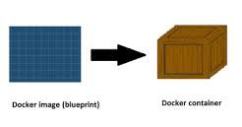
TERMINOLOGY
Image – blueprint of a container
Notes:
Images - the basis of a container. The blueprints of our application which form the basis of containers.
Images are read-only templates that you build from a set of instructions written in your Dockerfile. Images define both what you want your packaged application and its dependencies to look like *and* what processes to run when it’s launched.

Slide 10
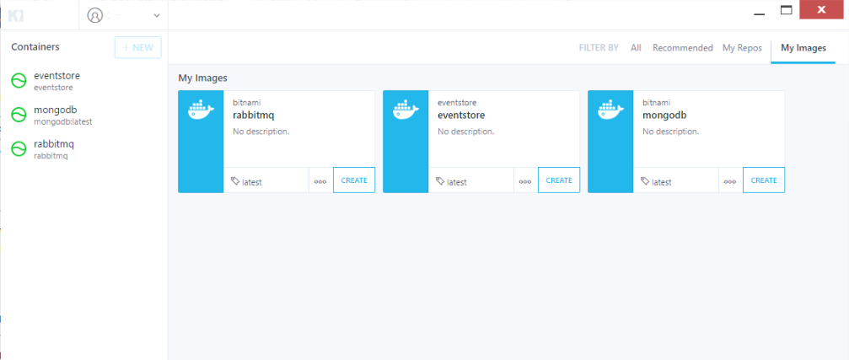
TERMINOLOGY
Docker client – command line tool
Notes:
Docker Client - The command line tool that allows the user to interact with the daemon. More generally, there can be other forms of clients too - such as Kitematic which provide a Graphical User Interface to the users.

Slide 11
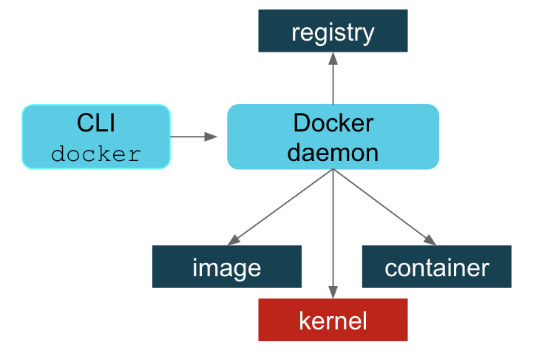
TERMINOLOGY
Docker daemon
background service running on the host
Notes:
Docker Daemon - The background service running on the host that manages building, running and distributing Docker containers. The daemon is the process that runs in the operating system which clients talk to.

Slide 12
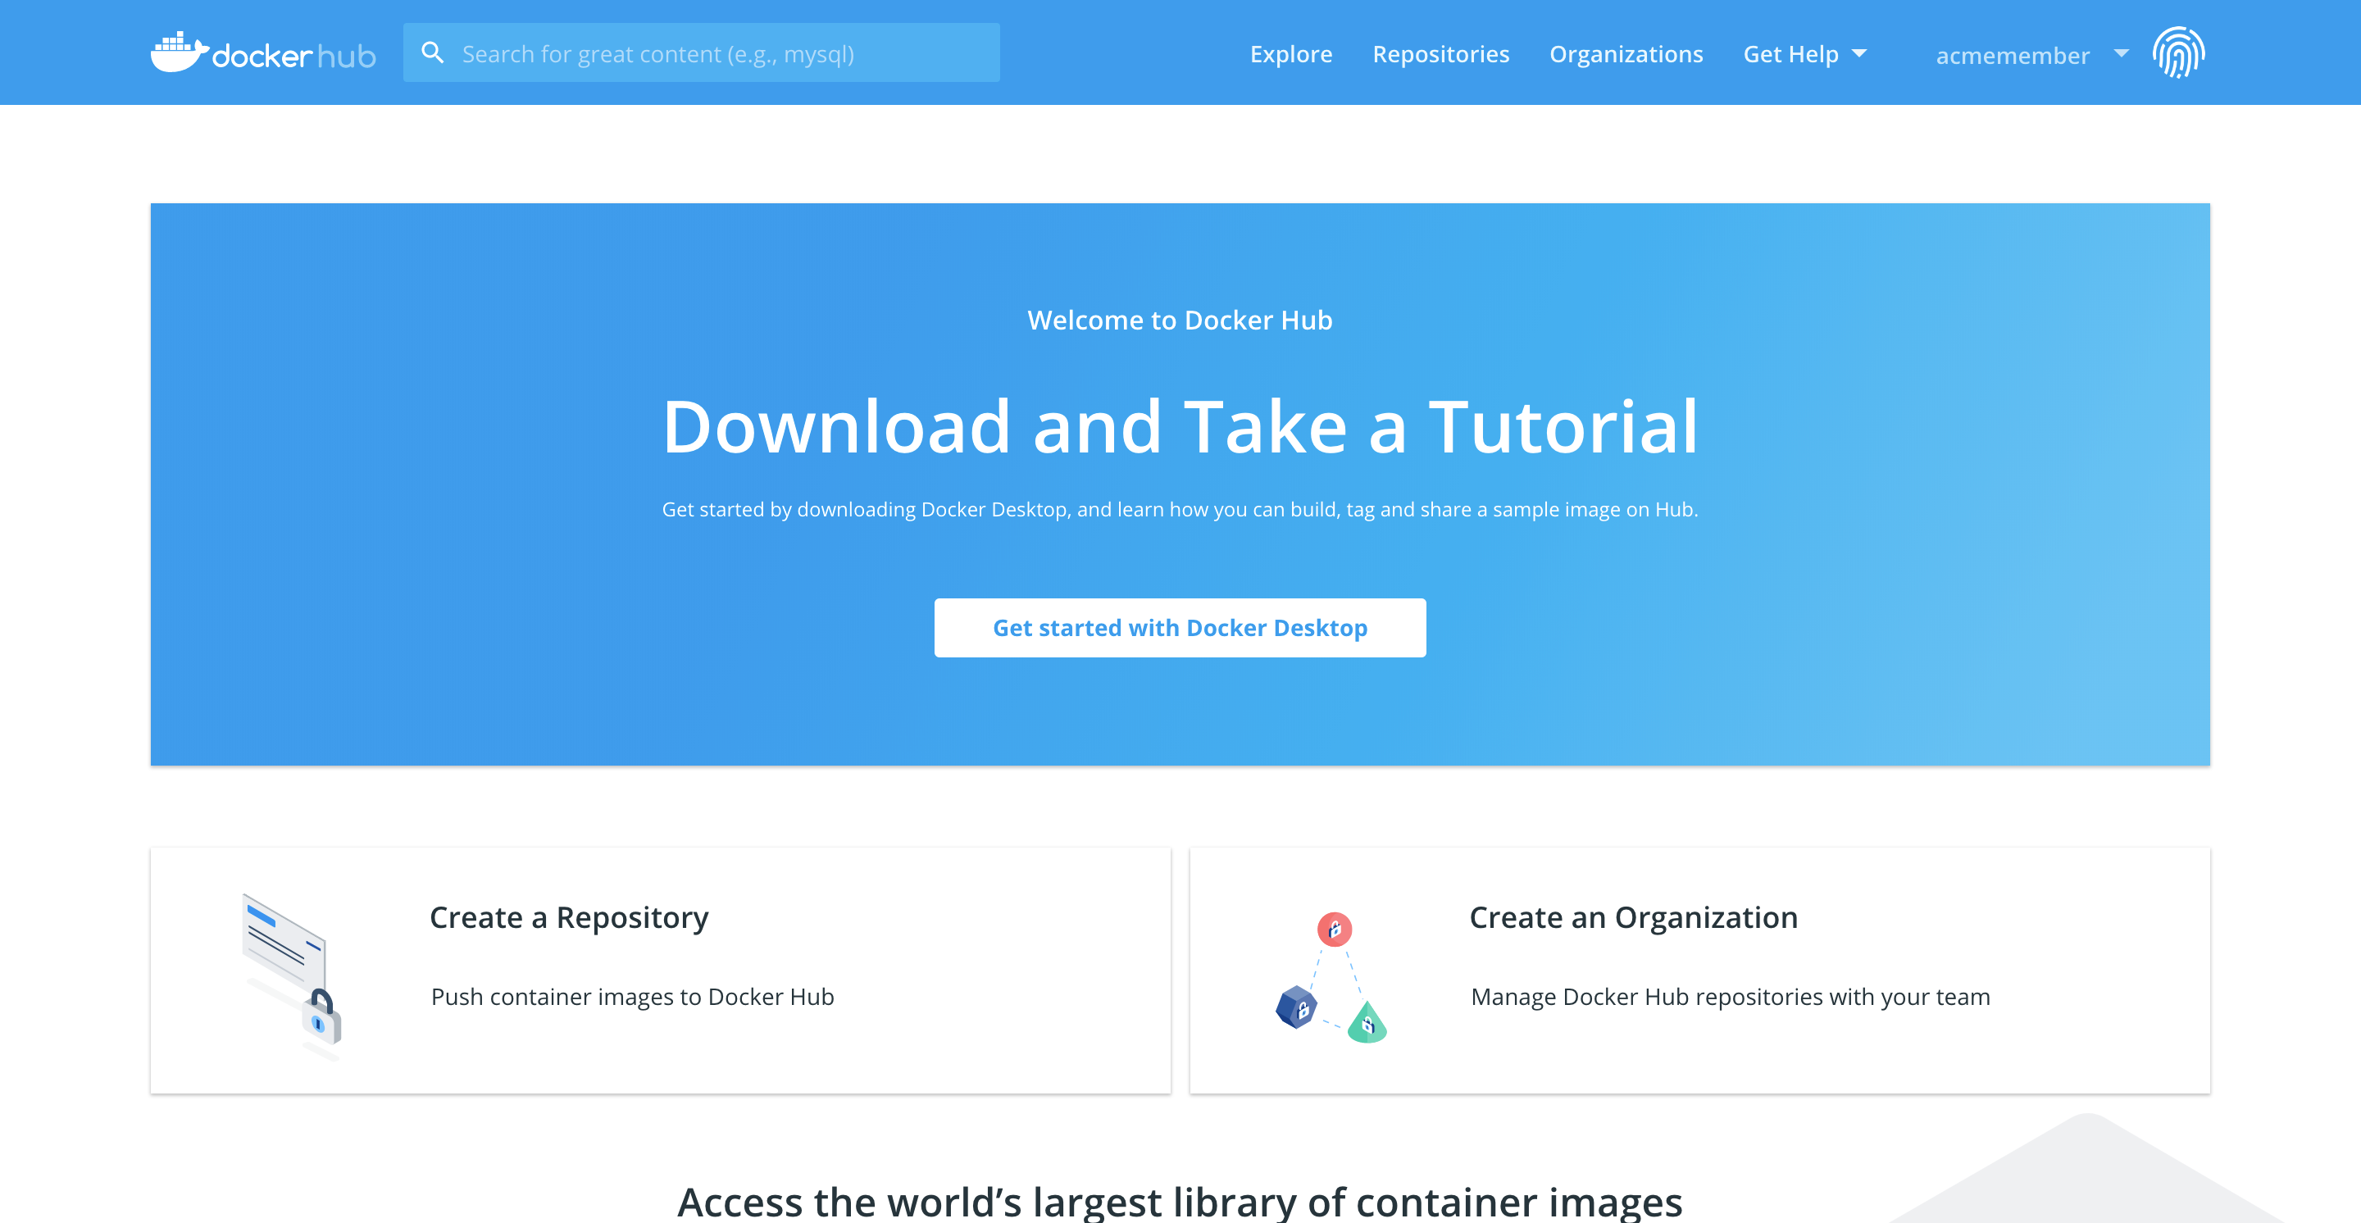
TERMINOLOGY
Docker Hub – registry of Docker images
Notes:
Docker Hub - A registry of Docker images. You can think of the registry as a directory of all available Docker images. Cloud based online respository that stores private and public repos. If required, one can host their own Docker registries and can use them for pulling images. Docker Hub is the place where open Docker images are stored. - go to docker hub

Slide 13
2 Benefits of Docker?
Let’s talk about the advantages of Docker

Slide 14
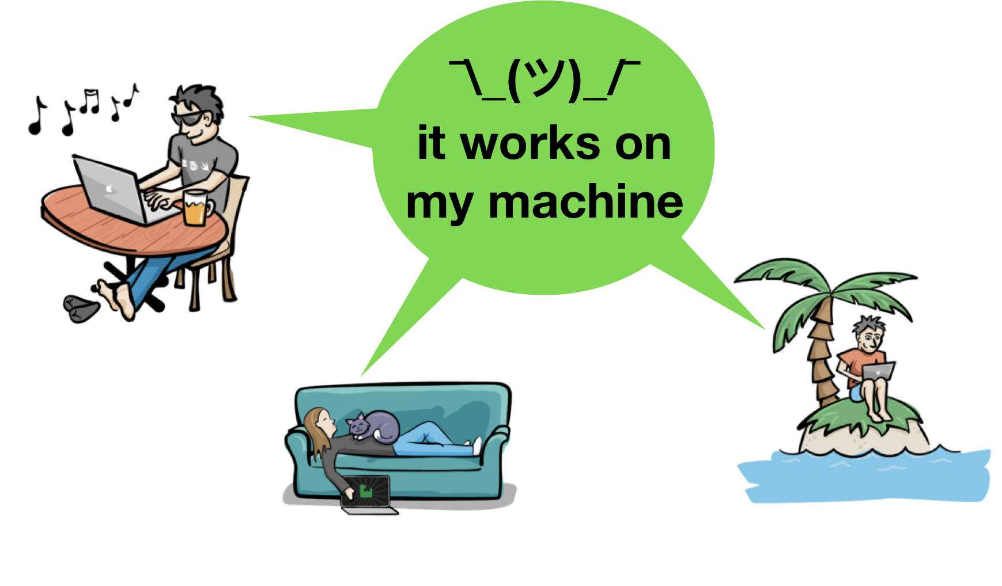

Slide 15
BENEFITS
Containers are independent of their host
Containers are very light weight
Host operating system and resources is shared
No provisioned RAM for applications – use when required basis
Versioning of software is much easier
Notes:
Containers are independent of their host
The host system does not affect how your containers work
Interaction with containers is identical across multiple hosts
PC, private clouds or public clouds remains the same
shared across multiple people and the container’s behavior will be the same across the many hosts, and interaction with the containers does not change
Containers share the same host OS
- Containers do not package the OS but the applications and its dependencies
- A single host can run multiple containers
Containers are very lightweight
As the containers share the same host and resources, they are very light weight, lighter than VMs
Containers take milliseconds to start up while VMs take seconds and sometimes longer
No provisioned RAM – use when required
No RAM needs to provisioned before starting any containers
Versioning of software is much easier
- tag versions of images for feature work
Easy to test different versions and makes rollbacks much easier as a tagged image can be used in case of broken builds/releases
Side note: you Can run multiple containers with an identical application as long as each one binds to its own port:
containers cannot share ports/access points

Slide 16
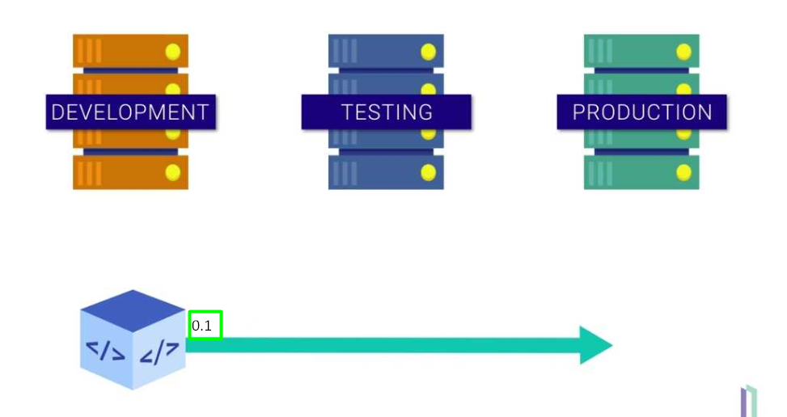

Slide 17
BENEFITS
Fully portable – code, dependencies, libraries etc.
Simple configuration
Containers can be integrated into existing infrastructures
Notes:
Fully portable – code, dependencies, libraries etc.
Simple configuration – Dockerfile
Containers can be integrated into existing infrastructures
Corporates with existing VM infrastructure can integrate Docker into their existing infrastructure
Changing applications’ infrastructure and architecture is not easy as this is something that would have been built over a long time

Slide 18
DEMO
Let’s say ‘Hello World’ from Docker

Slide 19

SOME USEFUL COMMANDS
docker pull {image_name}
docker images
docker run
docker ps
docker stop
docker restart
docker rmi

Slide 20
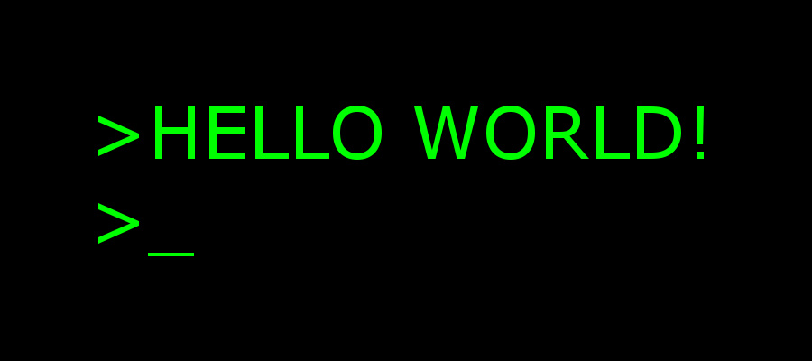
Pull and run the Hello world image
docker pull hello-world
docker images
docker run hello-world

Slide 21
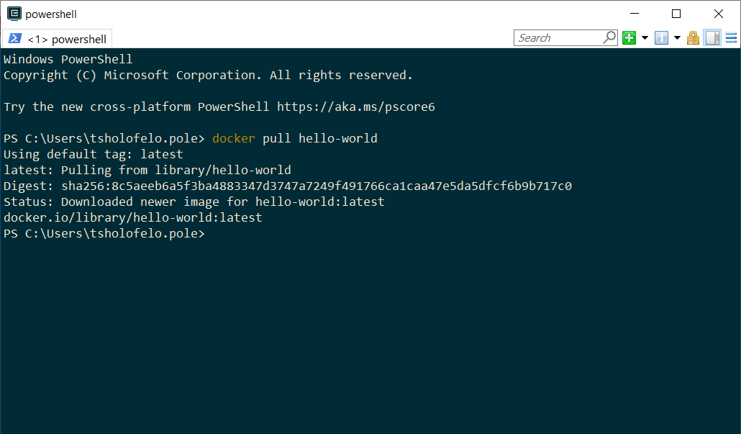
Pull the Hello world image

Slide 22
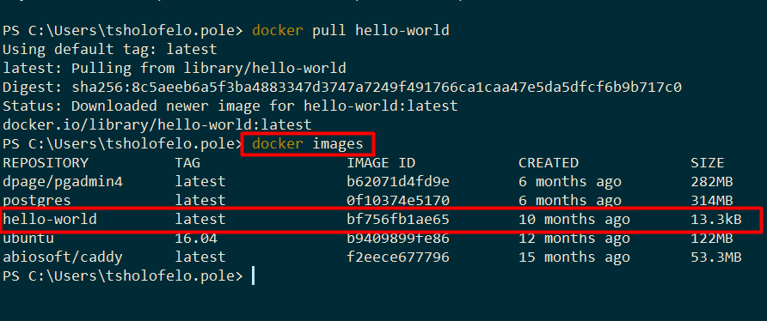
Pull the Hello world image

Slide 23
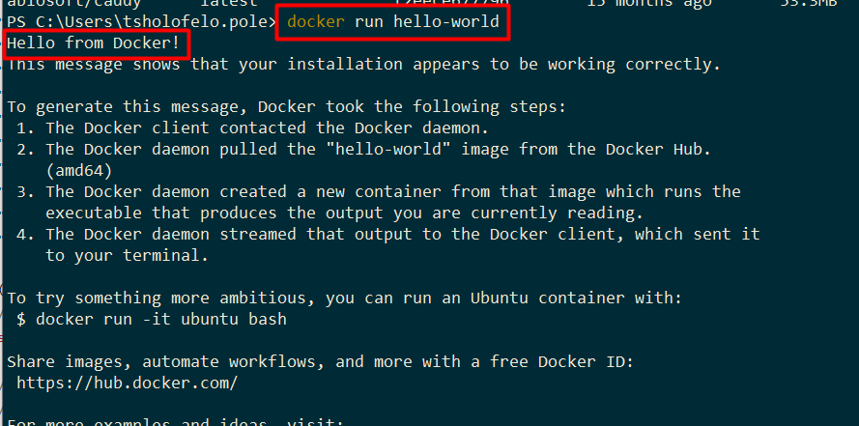

Slide 24
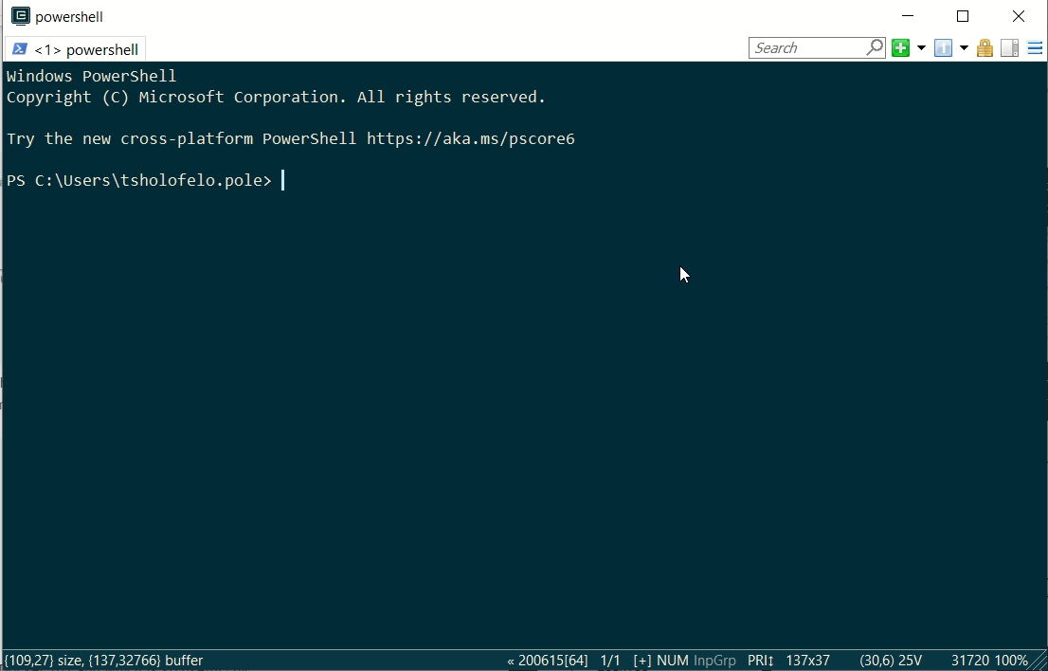

Slide 25
3
Advanced Demo
How about creating your own docker image?
Notes:
You can follow along, or if you do not have docker installed you can also just watch

Slide 26
Before we start
Download the sample app https://github.com/Mistborn94/docker-flask-demo
Open a terminal
Run ‘docker pull python:3-slim’
Notes:
Get download / repo link
Use terminal inside vs code
https://github.com/Mistborn94/docker-flask-demo

Slide 27
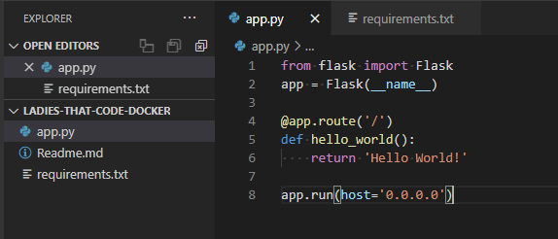
Before we start

Slide 28
A Dockerfile is a simple text file that contains a list of commands that the Docker client calls while creating an image.

Slide 29
Dockerfile
Create an empty file called “Dockerfile” in your project directory
Open the project in your code editor
Notes:
We will be building a web application using python flask so we want to start from the python 3 image. It already has python and pip – the python package manager installed

Slide 30
What goes in our dockerfile?
Start from a base image
Install dependencies
Copy our files
Expose a port
Run the application
Notes:
We are packaging a simple web application

Slide 31
Base Image
A starting point or an initial step for the image that we finally want to create
FROM python:3-slim
Notes:
We will be building a web application using python flask so we want to start from the python 3 image. It already has python and pip – the python package manager installed

Slide 32
Working Directory
The WORKDIR command changes the current working directory
FROM python:3-slim
WORKDIR /usr/src/app
Notes:
Now we need to set a working directory where we will install our application and its dependencies

Slide 33
Install Dependencies
Use the ‘RUN’ keyword to run any command
FROM python:3-slim
WORKDIR /usr/src/app
COPY requirements.txt .
RUN pip install -r requirements.txt
Notes:
Because we are using the python 3 base image, the pip command is already available for us to use

Slide 34
Add your files
Copy your source files to the image
FROM python:3
WORKDIR /usr/src/app
COPY requirements.txt .
RUN pip install -r requirements.txt
COPY app.py .

Slide 35
Expose a Port
We need to expose a port on our container for the webserver to run on
FROM python:3
WORKDIR /usr/src/app
COPY requirements.txt .
RUN pip install -r requirements.txt
COPY app.py .
EXPOSE 5000
Notes:
Because we are using the python 3 base image, the pip command is already available for us to use

Slide 36
Run the application
Tell the container what to do when it is started
FROM python:3
WORKDIR /usr/src/app
COPY requirements.txt .
RUN pip install -r requirements.txt
COPY app.py .
EXPOSE 5000
CMD ["python", "./app.py"]
Notes:
Because we are using the python 3 base image, the pip command is already available for us to use

Slide 37
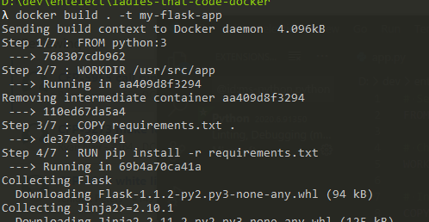
Build the image
‘docker build’ creates an image from the steps in your docker file
Notes:
Because we are using the python 3 base image, the pip command is already available for us to use

Slide 38
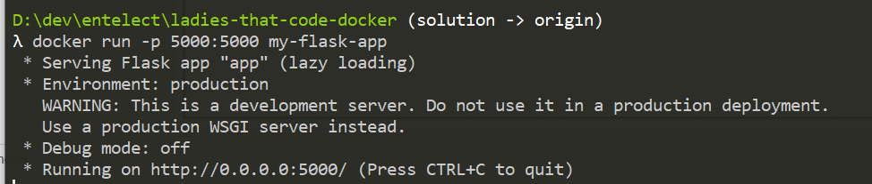
Run the container
‘Docker run’ turns an image into a running container

Slide 39
4
Advanced Concepts
All the other things you need to know about

Slide 40
Port Bindings
Expose your web application somehow
Link a container port to a port on your computer

Slide 41
Update & Rebuild
Update the image and run it again on a different port

Slide 42

Docker Images & Layers
Every command creates another layer
Docker ‘pull’ only downloads updated layers
Notes:
Writing a docker file is like building up a stack of papers. Every command you write adds another layer to the docker image,
When you update one of the latest layers, all the previous ones remain unchanged. Instead of pulling all 800mbs of your image, consumers can pull only the changed layers.
Explain Cache!!!

Slide 43
Docker Images & Layers
Stuff that changes frequently
(Bottom of dockerfile)
Stuff that doesn’t change
(Top of dockerfile)
Notes:
When you write a docker file it is important to keep that in mind.
Writing a docker file is like building up a stack of papers. Every command you write adds another layer to the docker image,

Slide 44
Stopping Containers
list running containers
docker ps
Stop and remove the containers
docker stop
docker rm

Slide 45
Interactive Mode
Interactive mode allows you to execute commands inside the container
Add the –it flag to docker run
Notes:
For example doing your development workflow inside the container, or just stopping the container when you press ctrl+c

Slide 46
Volumes
Directories or files shared between the container and the host file system
Persist State
Share between containers
VOLUME command in dockefile
-v flag on run

Slide 47
4
The docker landscape
All the other things you need to know about

Slide 48
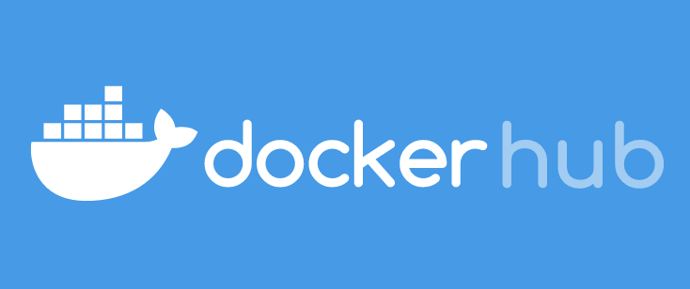
Container Registries: Sharing is caring
How do I share my container images with the world?
(or just with my team)
Notes:
To share your containers with other people, you need to publish them to a container registry. Docker hub is the largest container registry and the default one.
Docker Hub is a hosted repository service provided by Docker for finding and sharing container images with your team. You can publish your images there or pull other images from it.
You can use docker hub for free, but there are some limitations. You can only get one private repository for free
When we use the docker pull and push commands it goes to dockerhub by default , but you can also point to other container registries: For example, a company might have a private registry for their own applications.

Slide 49


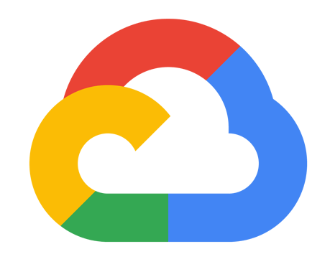
What about the cloud?
Easily deploy anywhere
Notes:
You can easily run your docker containers in the cloud. AWS, Azure and Google cloud platform all have tools to easily deploy applications packaged into docker containers

Slide 50
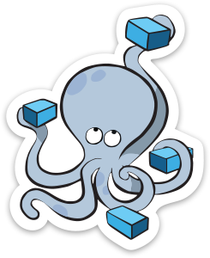
Container Orchestration
Running multiple containers together gets complicated
Notes:
Container orchestration is the automatic process of managing or scheduling the work of individual containers for applications based on microservices
On the one hand we have docker compose. Docker compose comes with a basic docker installation and is pretty simple to get started with. It is ideal for a local development environment where you need multiple containers talking to each other.
On the other hand we have Kubernetes. Kubernetes is incredibly powerful, but also quite complex.
Another container orchestration tool you might here about is openshift. Openshift is very similar to Kubernetes and is actually built on top of it but comes with a bunch of features to make your life easier.

Slide 51
Container Orchestration?
Configuration
Scheduling
Scaling
Load Balancing
Health Monitoring
Deployments
Notes:
Container orchestration is the automatic process of managing or scheduling the work of individual containers for applications based on microservices
On the one hand we have docker compose. Docker compose comes with a basic docker installation and is pretty simple to get started with. It is ideal for a local development environment where you need multiple containers talking to each other.
On the other hand we have Kubernetes. Kubernetes is incredibly powerful, but also quite complex.
Another container orchestration tool you might here about is openshift. Openshift is very similar to Kubernetes and is actually built on top of it but comes with a bunch of features to make your life easier.

Slide 52


Container Orchestration
Docker Compose
Kubernetes
Openshift
Notes:
Container orchestration is the automatic process of managing or scheduling the work of individual containers for applications based on microservices
On the one hand we have docker compose. Docker compose comes with a basic docker installation and is pretty simple to get started with. It is ideal for a local development environment where you need multiple containers talking to each other, but it does not have that many features and is less suited to complex enterprise architectures with many more containers.
On the other hand we have Kubernetes. Kubernetes is incredibly powerful, but also quite complex. It has many more features and concepts, but allows you to replicate and scale up groups of containers, load balance between them or upgraded them/.
Another container orchestration tool you might here about is openshift. Openshift is very similar to Kubernetes and is actually built on top of it but is a commercial product distributed by readhat. It comes with more productivity and security features to streamline your work process and also enterprise support from redhat.

Slide 53
Thanks for joining!
Any Questions?

